Slide 1

CSC650 Secure Networked Systems
Introduction
Professor Hao Yue
Spring 2016

Slide 2

Welcome!

Slide 3
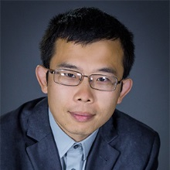
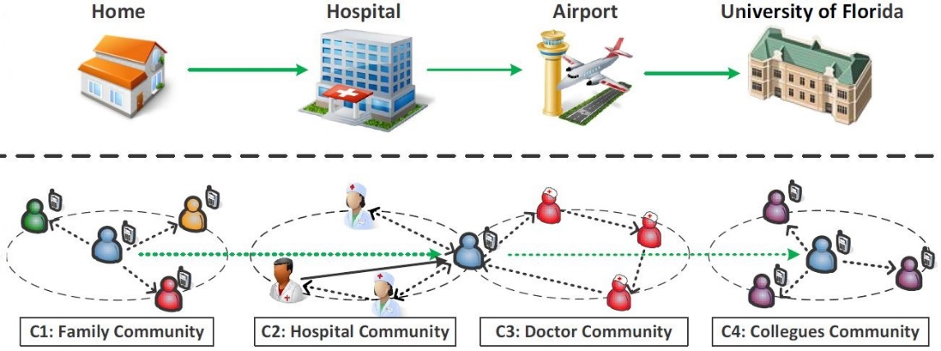
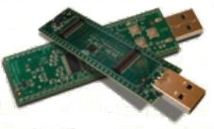
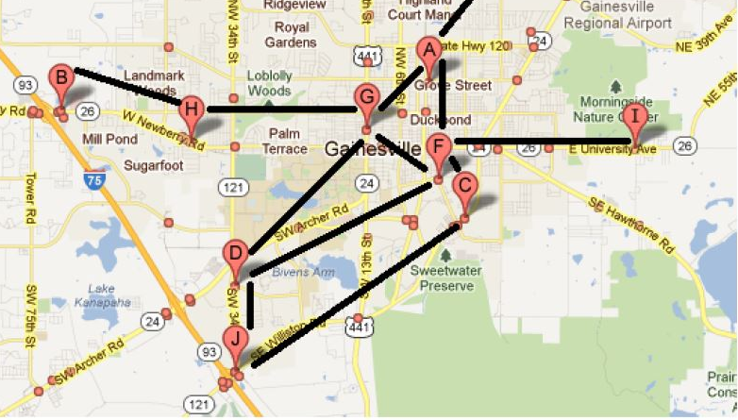
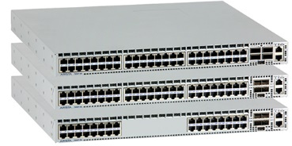
Who am I
Hao Yue
Assistant Professor
Email: haoyue@sfsu.edu
Homepage: TBA
Research Interests:
Wireless Networks
Mobile Computing
Computer and Network Security
Internet of Things

Slide 4

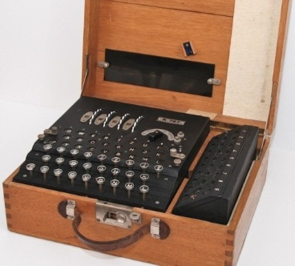
Past
If he had anything confidential to say, he wrote it in cipher, that is, by so changing the order of the letters of the alphabet, that not a word could be made out. If anyone wishes to decipher these, and get at their meaning, he must substitute the fourth letter of the alphabet, namely D, for A, and so with the others.
-- Suetonius, Life of Julius Caesar
Notes:
Enigma

Slide 5
Now
Security stories in the past 24 hours
A serious security flaw was found in eBay, which could leave buyers and sellers vulnerable to hack attacks
Vulnerability discovered in Children’s Internet-connected toy
Nokia released a new Internet-of-Thing security tool to monitor and control all the components on a network
J. P. Morgan announced it is planning to invest a half-billion dollars in security
…

Slide 6
Course Overview
This course introduces the fundamental concepts on computer security and standard security mechanisms and protocols.
Topics will include Secret Key Cryptography, Public Key Cryptography, Authentication, Network Security, Intrusion Detection, DDoS, Web Security, DES, RSA, IPsec, SSL/TLS, and other emerging topics (as time permits).

Slide 7
Learning Outcome
Students successfully completing this course will
Have basic knowledge on cryptography and standard network security mechanisms
Gain hands-on experience in implementing security mechanisms and building secure systems

Slide 8

General Info
Instructor: Hao Yue
Class Time/Location: Tuesday, 7:00PM – 9:45PM, TH429
Office: TH930
Office Hours: Wednesday 11:00AM-12:00PM and 5PM-6PM, or by appointment
Email: haoyue@sfsu.edu
TA: TBA

Slide 9

Class Time
One class is divided into three sessions
Session 1: 7:00-7:50PM
Break: 7:50-8:00PM
Session 2: 8:00-8:50PM
Break: 8:50-9:00PM
Session 3: 9:00-9:45PM

Slide 10
You need to know
Operating Systems
Computer Networks
C/C++ programming language
Please contact the instructor if you have questions regarding the concerns about whether your background is suitable for the course.

Slide 11
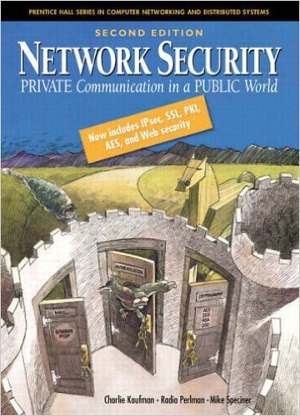
Course Materials
Textbook
Network Security: Private Communication in a Public World, 2nd Edition, by Charlie Kaufman, Radia Perlman and Mike Speciner
Course slides, assignments, and other materials will be made available on iLearn.

Slide 12

Grading
Grading will be distributed as follows:
10% Attendance and Quizzes
15% Homework Assignments
20% Course Projects
25% Midterm Exam
30% Final Exam
Final scores will be converted to letter grades
based on a class curve
You get the grade that you earn, so be sure that
you earn a grade you like.

Slide 13
Grading
Assignments
Three homework assignments. Each counts for 5% of the final grade.
Two project assignments. Each counts for 10% of the final grade.
Exams
One closed-book, closed-notes midterm and one take-home final exam
Attendance and Quizzes
Five roll-calls. Each counts for 1% of the final grade.
Quizzes count for 5% of the final grade in total
Class Participation
Students actively participating in class will receive up to 5 bonus points in the final grade

Slide 14

Lateness
All assignments are due at the beginning of class
Late submission within 48 hours of the deadline is allowed, for 75% of the credits
Students with legitimate reasons should contact the instructor before the deadline to ask for an extension
Unless the problem is apocalyptic, don’t give me excuses
Start to work on the assignments as early
as possible

Slide 15
Academic Integrity
As scientists and engineering, we must trust each other to make progress
Academic dishonesty, whether from cheating, copying, fabricating results or through any other dishonest practice will not be tolerated
Refer to the link http://cs.sfsu.edu/plagarism.html for the department policy on plagiarism/cheating
I take this very seriously – you should too.

Slide 16
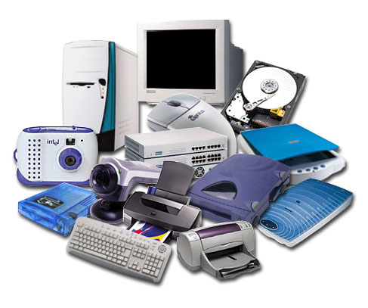


What is security?
Security is the protection of the items you value, called assets
Assets of computer systems
Hardware
Software
Data
Notes:
Why protect assets: 1 value; 2 at risk
----------
Lecture 1 start
George’s notes
Assets - items you value
confidentiality

Slide 17
Security Goals
C-I-A Triad
Confidentiality: information or resources can only be accessed and viewed by authorized parties
Integrity: information or resources can be modified only by authorized parties
Availability: information or resources accessible to authorized parties at appropriate times
Notes:
Protection on which aspects of assets
-------
C-I-A Triad
Confidentiality: information or resources can only be accessed and viewed by authorized parties
Integrity: information or resources can be modified only by authorized parties
Availability: information or resources accessible to authorized parties at appropriate times
Dos. Single entity
Ddos. Multiple entities

Slide 18
Threats
A threat is a set of circumstances that has the potential to cause loss or harm to a system
An ability of an attacker
E.g., eavesdrop on a communication channel
A threat model is a collection of threats that deemed important for a particular system
A collection of attacker(s) abilities
E.g., A powerful attacker can read and modify all communications and generate messages on a communication channel
Notes:
Threat - a set of circumstances that has the potential to cause loss or harm to a system
threat model - a collection of threats that deemed important for a particular system

Slide 19
Vulnerabilities
A vulnerability is a weakness that may be exploited to cause a threat
E.g., easy-to-guess password
Sources of a vulnerability
Bad software or hardware
Bad design or requirements
Bad policy
System misuse
…
Notes:
Vulnerability - a weakness that may be exploited to cause a threat

Slide 20
Attacks
An attack occurs when someone attempts to exploit a vulnerability
Passive attacks (e.g., eavesdropping, traffic analysis)
Active attacks (e.g., message modification, message replay, Denial of Service)
A compromise occurs when an attack is successful
Notes:
attack - occurs when someone attempts to exploit a vulnerability
compromise - occurs when an attack is successful

Slide 21

Participants and Adversaries
Participants are expected system entities
Computers, agents, people, enterprises, …
Depending on context referred to as: servers, clients, users, entities, hosts, routers, …
An adversary is anyone attempting to launch an attack
Could users be adversaries?
Notes:
Participants - expected system entities
adversary - anyone attempting to launch an attack

Slide 22
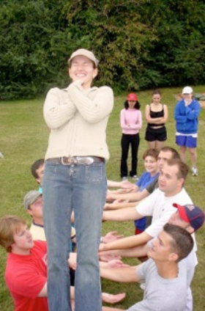
Trust
Trust refers to the degree to which an entity is expected to behave
A trust model describes, for a particular environment, who is trusted to do what.
We make trust decisions every day…

Slide 23
Security Model
A security model is the combination of a trust and threat models that address the set of perceived risks
Every design must have security model
The single biggest mistake seen in use of security is the lack of a coherent security model
This class is going to talk a lot about security models
What are the threats?
Who are our adversaries?
Who do we trust and to do what?

Slide 24
A Security Model Example
Assume we have a University website that hosts courses through the web (e.g., iLearn)
Syllabus, other course information
Assignments submissions
Online Grading
In class: elements of the security model
Participants (Trusted)
Adversaries
Threats

